Slide 1

BalanceMind
Platform and mobile app to help with mental health.
A good balance between your body, mind, and feelings in one easy-to-use digital place.
Presentation By
Khayatkhan Satymbekova
Year: 2025

Slide 2






BalanceMind
The project is for people who want to feel better inside, learn about their emotions (emotional intelligence), feel more confident, and create healthy habits.
BalanceMind is a modern digital tool. It includes a website and a mobile app.
The app helps you understand your feelings, think about your emotions, make your life better, and keep your mind healthy.
It was made to help people with their mental, emotional, and physical health.
The main idea is to give people an easy, safe, and science-based tool for daily self-care.

Slide 3

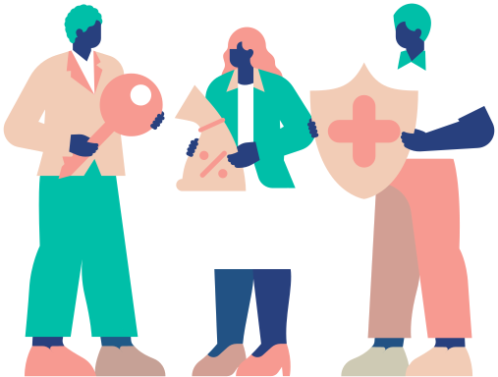



Project Need (Why this is important)
Mental health is a main part of having a good life.
Today, many people deal with problems like:
Stress and worry
Feeling completely exhausted (burnout)
Problems with self-worth
Not having the habit of being mindful (mindfulness)
Family and personal difficulties
Poor sleep and low energy
Modern users do not have one easy platform that brings together mental support, mindfulness practices, journals, trackers, podcasts, and tools for self-improvement—all in one place.

Slide 4



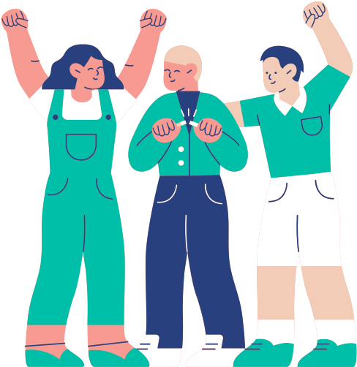

Project Goal
(What we want to do)
To build a simple platform (website and mobile app) that helps people take care of their mental, emotional, and physical well-being every day.
It will do this through:
Mindfulness exercises
Journals
Trackers
Psychological information
Personal advice

Slide 5


Project Tasks
(How we will reach our goal)
To reach its main goal, the BalanceMind platform will work on these tasks:
Creating Good Habits
Supporting Mental Health
01
Daily mindfulness
Keeping journals
Managing feelings
Building self-confidence
02
Access to psychology materials
Exercises and training
Tips to feel better
Growing Emotional Intelligence
Improving Physical Health
03
Understanding your own feelings
Learning to express feelings
Making communication better
04
Sleep tracker
Energy tracker
Basic tips for food, exercise, and yoga
Building One Easy Digital Place
05
A website with learning materials
An app with practical tools
Data synchronization (data works together)

Slide 6

Target Audience (Who this is for)
BalanceMind is for a wide group of people who care about their mental and emotional health:
Teens and students who feel stress.
Young adults who want to grow personally.
New parents who want to keep their emotional balance.
People who feel completely burnt out (emotional exhaustion).
Men and women (ages 18–45) who want harmony and confidence.
Anyone who wants to make their life and mental state better.
📌 The main point: The platform is good for beginners and also for people who already know about self-improvement and mental health practices.

Slide 7




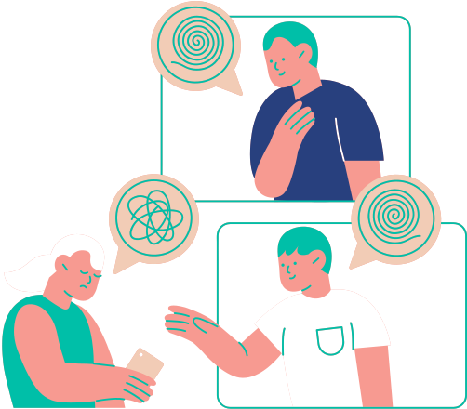


Project Structure (How the platform is built)
The BalanceMind platform has two main parts that work together:
💻 Web Platform
📱 Mobile App
Learning materials: articles, videos, books, and podcasts
Online tests and training courses
Personal area with charts, statistics, and analysis
Suggestions and plans for growth
Journals and mood trackers
Practices for meditation, affirmations, breathing, and yoga
Mental tests and exercises
Personal area showing your progress and achievements
AI assistant for personal suggestions
📌 Summary: Both parts work together (synced) to create one digital system for taking care of your mental health every day.

Slide 8
Main Sections of the Platform
The BalanceMind platform has 6 key sections:
1. Practices (Exercises)
Meditations
Affirmations
Breathing exercises
Yoga and stretching
Mindfulness exercises
2. Journals (Diaries)
Gratitude journal (thankfulness)
Daily journal
Dreams and goals journal
Emotions journal
"Parents and me" journal
Self-love journal
Working on childhood traumas
3. Self-Development and Psychology
Emotional intelligence
Self-confidence
Mental health
Feelings and emotions
Love for the world
Empathy and sensitivity
4. Learning Content
Books
Podcasts
Video lessons
Training and courses
5. Body and Health
Healthy eating
Exercise and activity
Sleep tracker
Body energy
6. Personal Account (User Profile)
User progress
Statistics and charts
Achievements (things you have done)
Personal recommendations (advice)
Goal planning

Slide 9
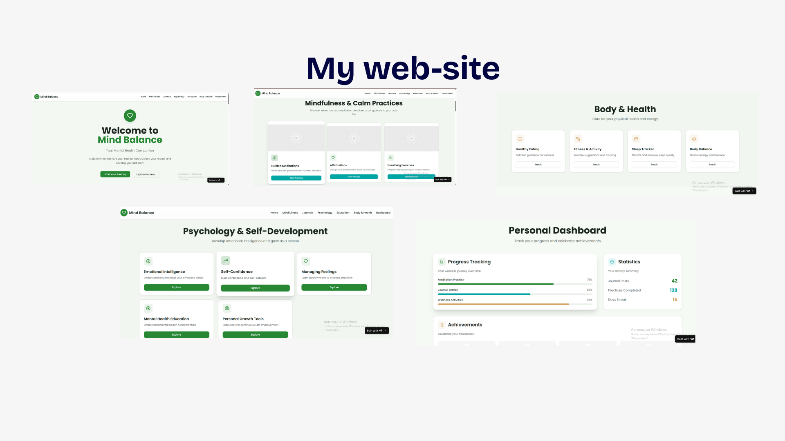

Slide 10
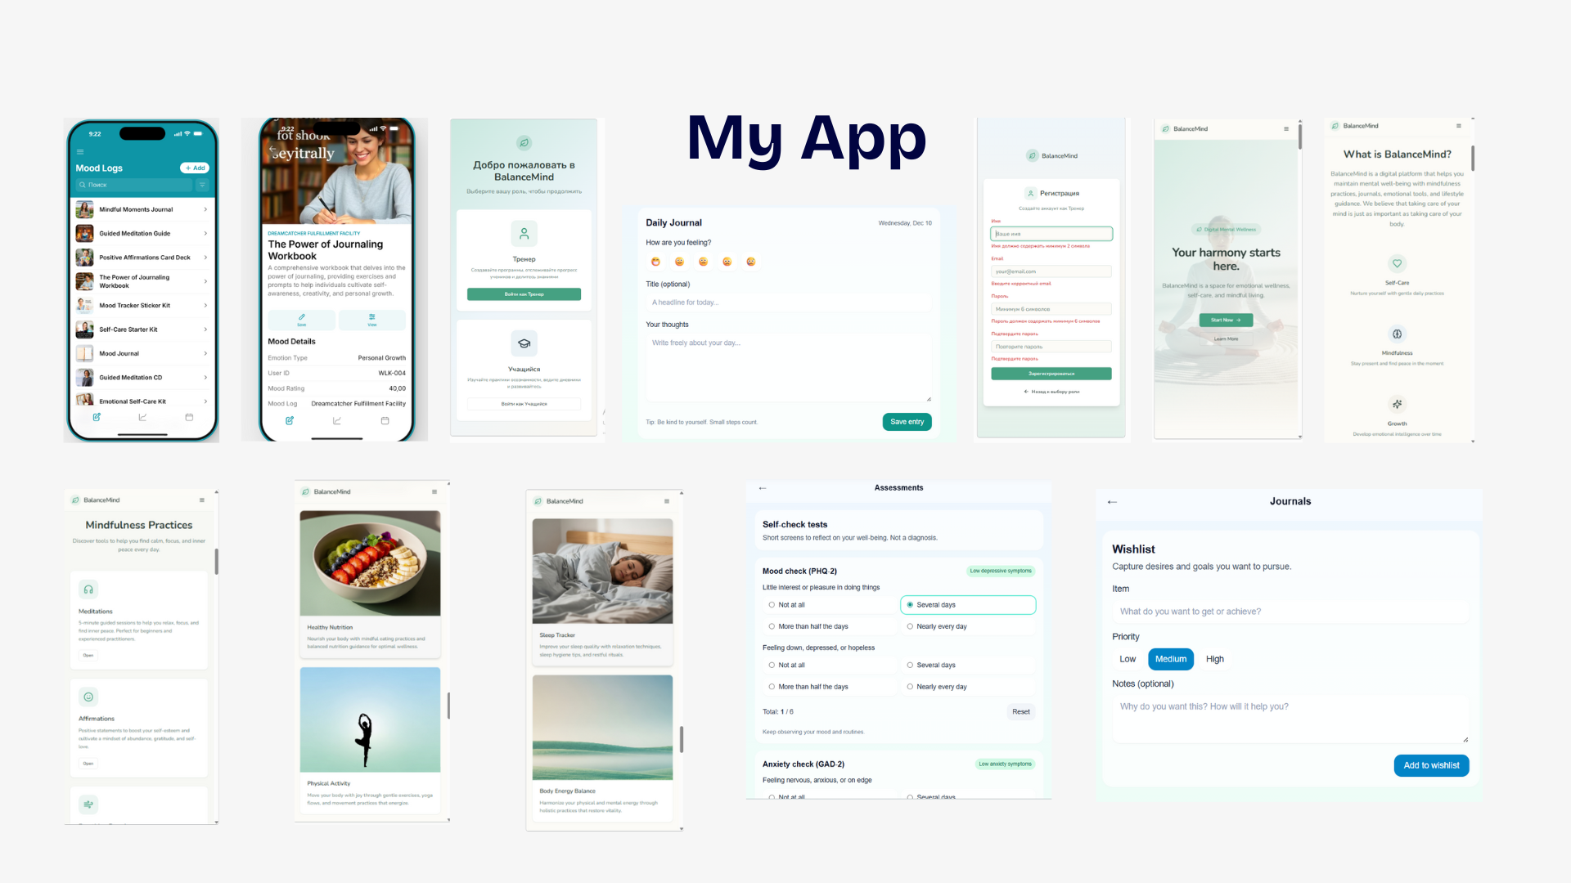

Slide 11
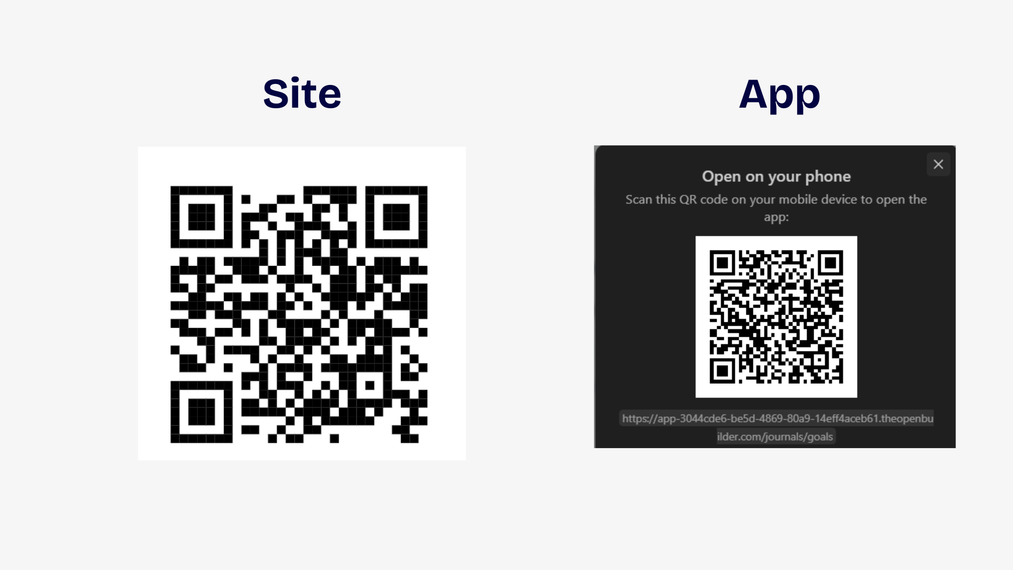

Slide 12



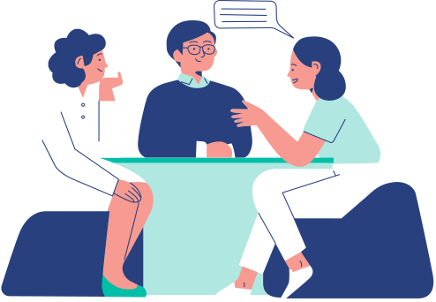
Conclusion
BalanceMind is a modern, easy-to-use, and helpful platform for mental health.
It helps people:
Become calmer and more self-confident
Improve their emotional state
Grow mindfulness and emotional intelligence
Form good habits and take care of their body
Increase life quality and inner peace
The platform brings together journals, exercises, and learning content, creating a safe space for daily self-care.

Slide 13


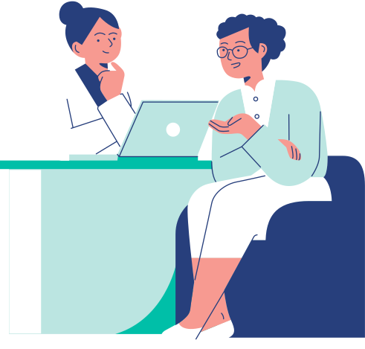
Thank You!

